Slide 1


Network protocols & security
24EC2210
Topic:
OSI REFERENCE MODEL
&
TCP/IP REFERENCE MODEL
Session – 4

Slide 2



AIM OF THE SESSION
To make the students understand the Data Transmission process using Reference Models.
INSTRUCTIONAL OBJECTIVES
This Session is designed to:
Describe how OSI reference model and TCP/IP protocol suite enables data communication.
Learn the responsibilities of each layer and the working.
Infer the difference between the network models.
LEARNING OUTCOMES
At the end of this session, you should be able to:
List out the process of Network communication.
Identify the difference between the Networking models.
Summarize advantages and disadvantages of the networking models.

Slide 3
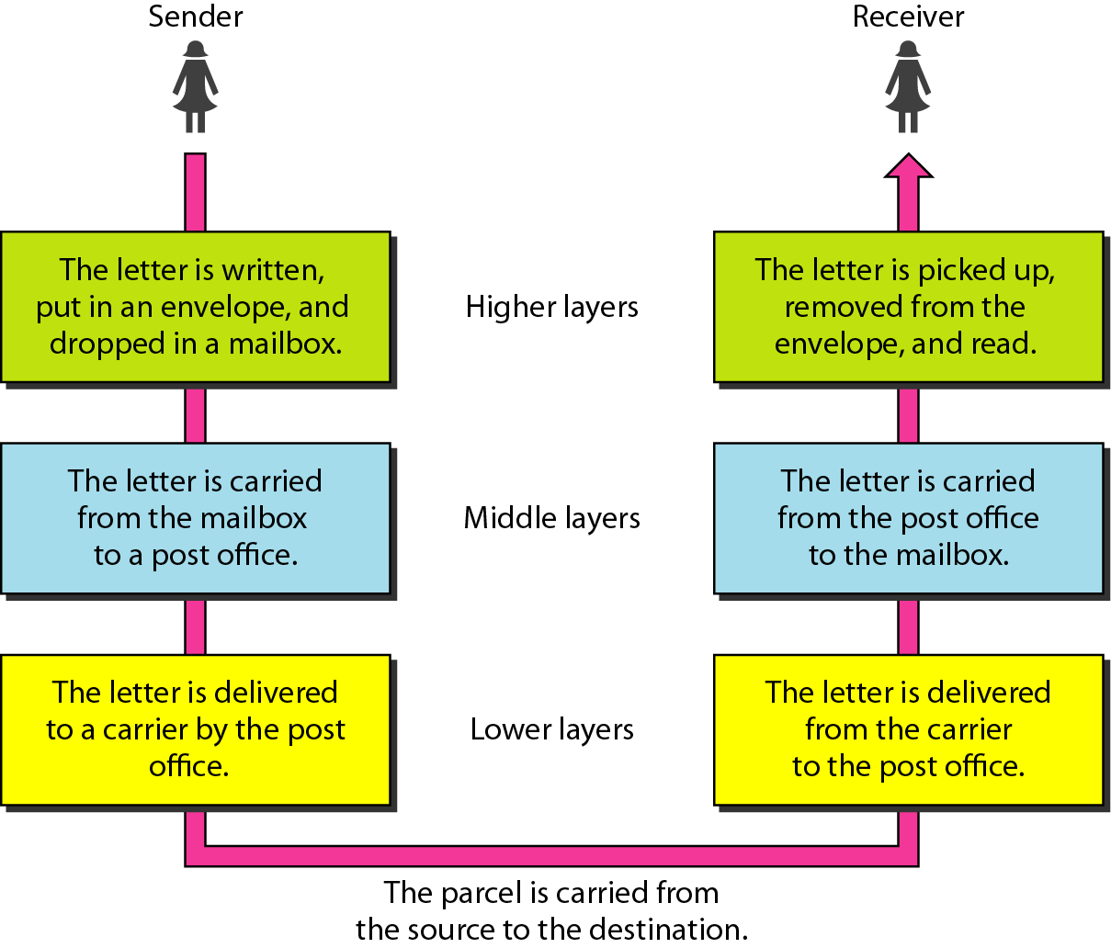
LAYERED TASKS
Layers concept in daily life, Example: Sending a letter to friend.

Slide 4
THE OSI MODEL
Established in 1947, the International Standards Organization (ISO) is a multinational body dedicated to worldwide agreement on international standards.
An ISO standard that covers all aspects of network communications is the Open Systems Interconnection (OSI) model. It was first introduced in the late 1970s.
The OSI model shows how to facilitate communication between different systems without requiring changes to the logic of the underlying hardware and software.

Slide 5
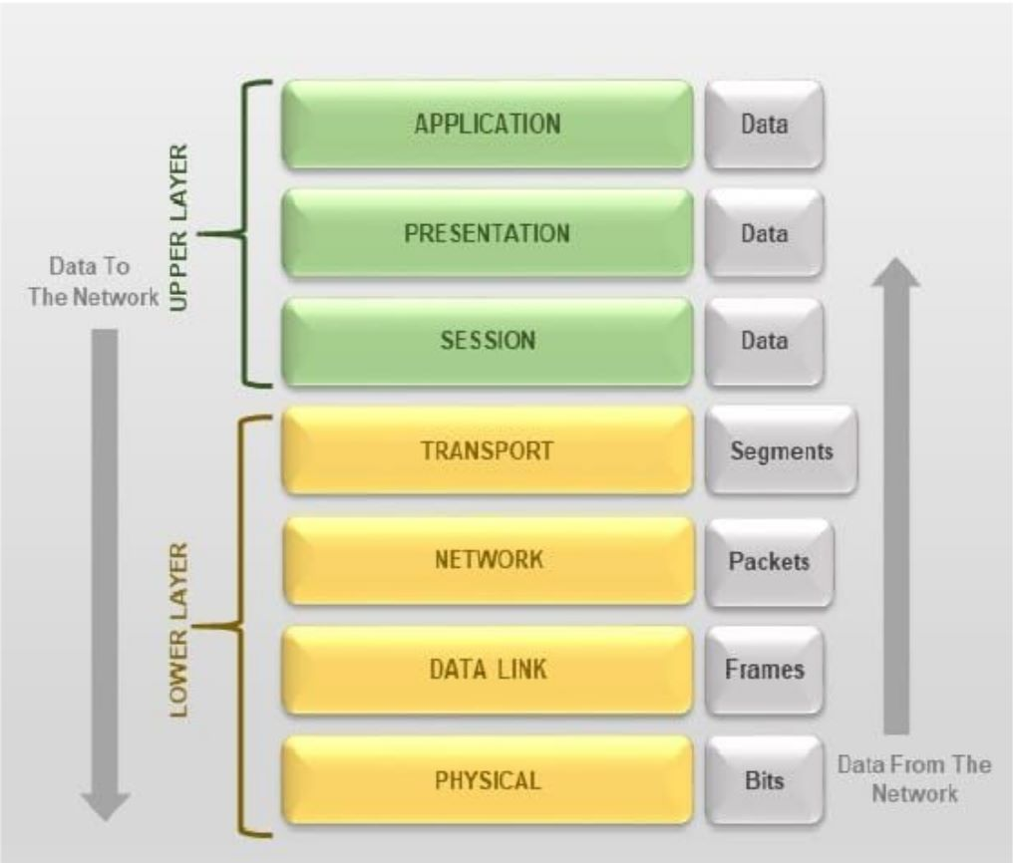
Seven Layers in OSI model

Slide 6
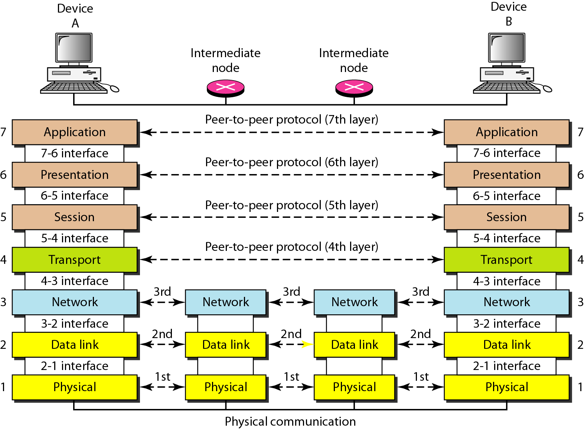
The interaction between layers in the OSI model

Slide 7
Peer to Peer Process
There is an interface between each pair of adjacent layers. This interface defines what information and services a layer must provide for the layer above it.
Layer 3, for example, uses the services provided by layer 2 and provides services for layer 4.
Between machines, layer x on one machine communicates with layer x on another machine, by using a protocol (this is Peer-to-Peer Process).
Communication between machines is therefore a peer-to-peer process using protocols appropriate to a given layer.

Slide 8
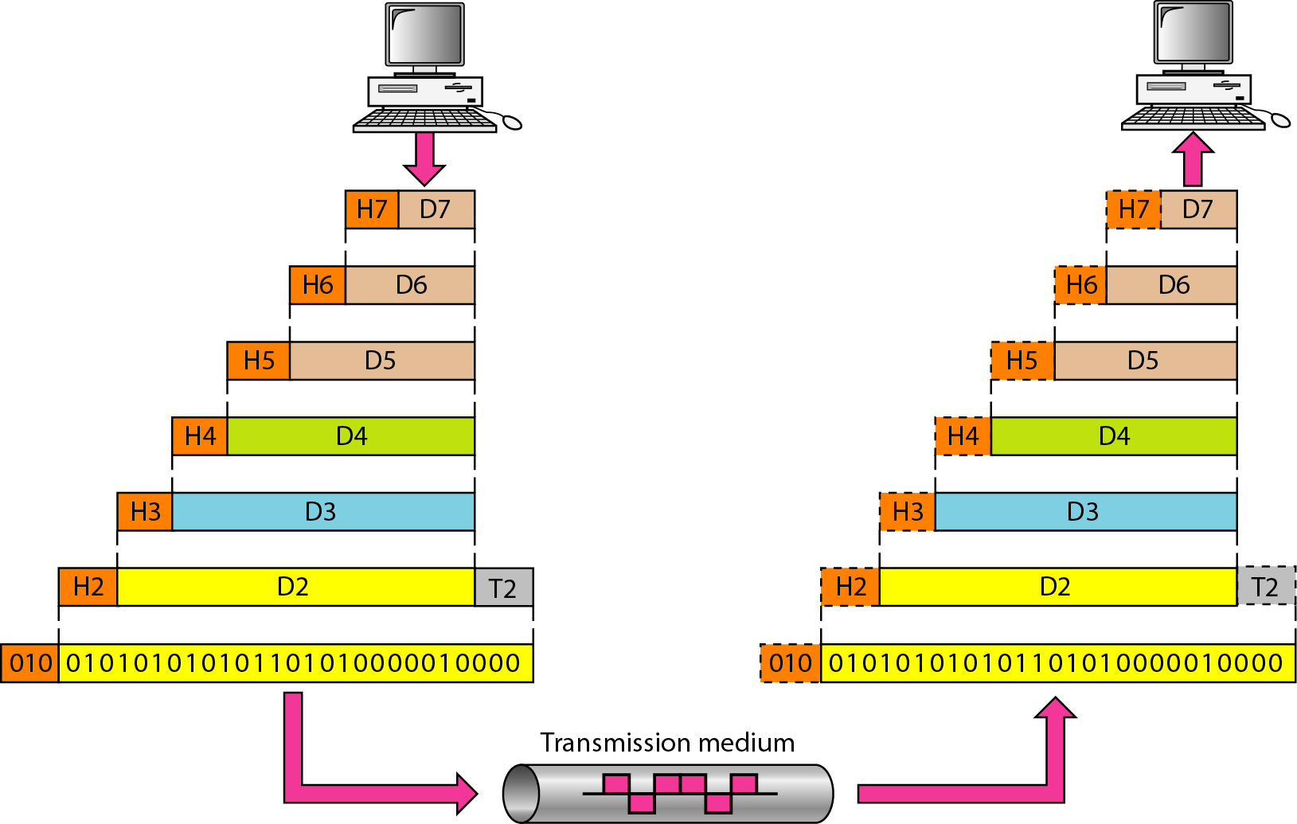
An exchange using the OSI model

Slide 9
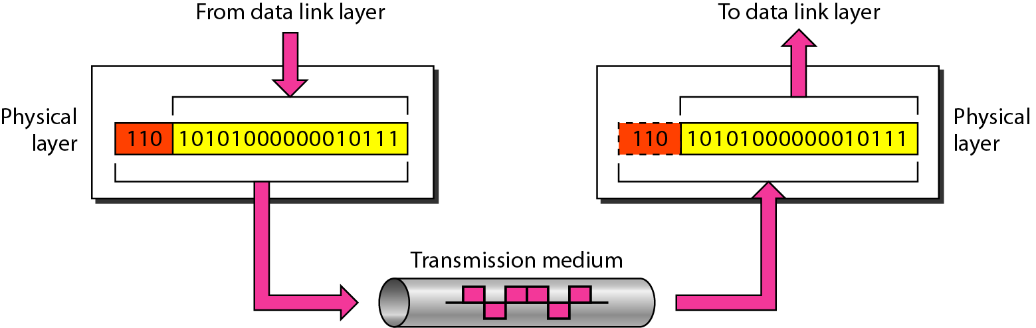
1. Physical Layer
The physical layer is responsible for transmitting individual bits from one node to the next.

Slide 10
Responsibilities of Physical Layer
Physical characteristics of interfaces and media: It define the type of transmission media.
Representation of the bits: the physical layer data consist of a stream of bits(0,1). The transmitted bits must be encoded into signals – electrical or optical. The physical layer defines the type of encoding.
Data rate: The physical layer defines the transmission rate, the number of bits sent each second.
Line configuration: Connection of devices to the medium (point-to-point and multipoint configuration)
Physical topology: Mesh, Bus, Star, Ring and Hybrid Topology.
Transmission Mode: Simplex, Half duplex Full Duplex

Slide 11
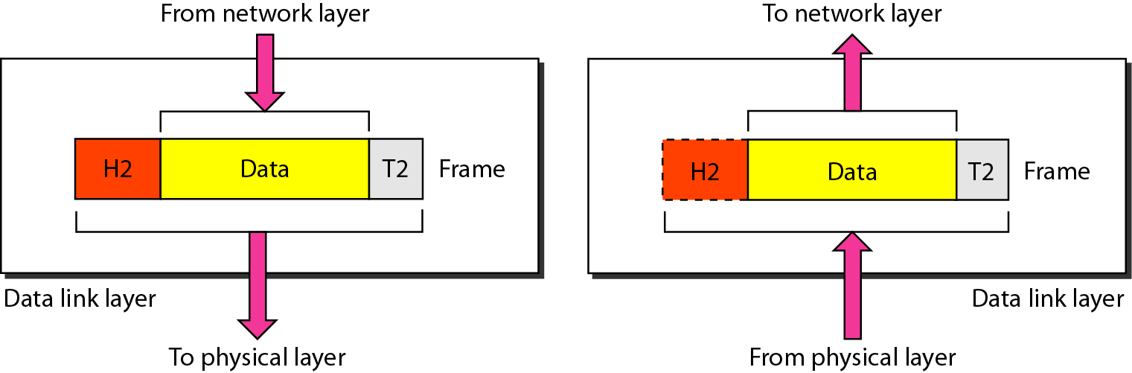
Data link layer
It is responsible for node-to-node delivery of data.
The data link layer is responsible for moving frames from one hop (node) to the next.

Slide 12
Responsibilities of Data link layer
Framing: The data link layer divides the stream of bits received from the network layer into data units called frames.
Physical addressing: If frames are to be distributed to different systems on the network, the data link layer adds a header to the frame to define the physical address of the sender (source address) and/or receiver (destination address) of the frame.
Flow Control: If the rate at which the data are absorbed by the receiver is less than the rate produced in the sender, the data link layer imposes a flow control mechanism to prevent overwhelming the receiver.
Error control. The data link layer adds reliability to the physical layer by adding mechanisms to detect and retransmit damaged or lost frames. Error control is normally achieved through a trailer to the end of the frame.
Access Control. When two or more devices are connected to the same link, data link layer protocols are necessary to determine which device has control over the link at any time.

Slide 13
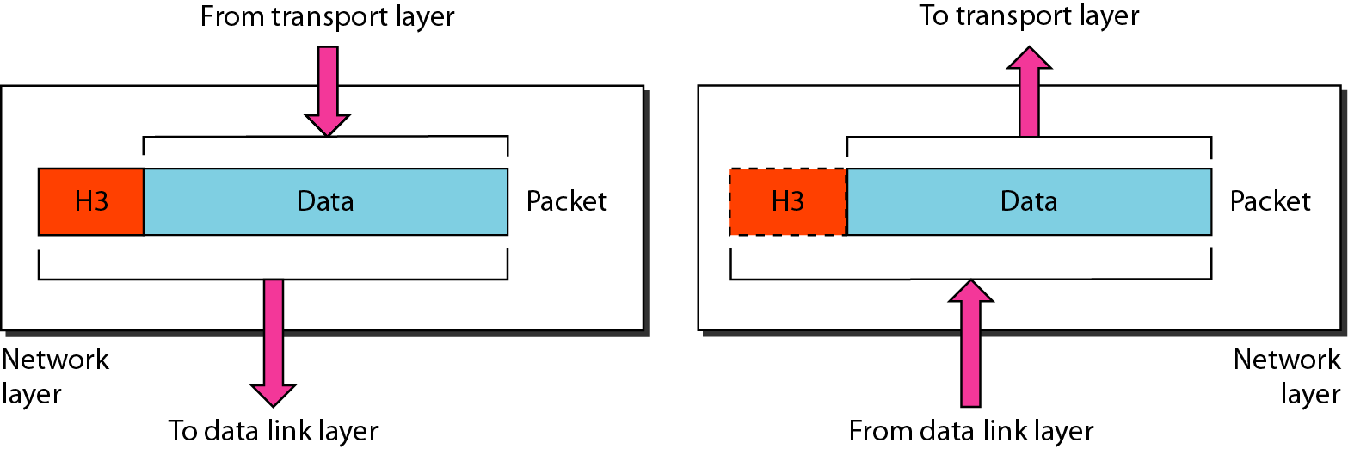
Network Layer
The network layer is responsible for the delivery of individual packets from the source host to the destination host.

Slide 14
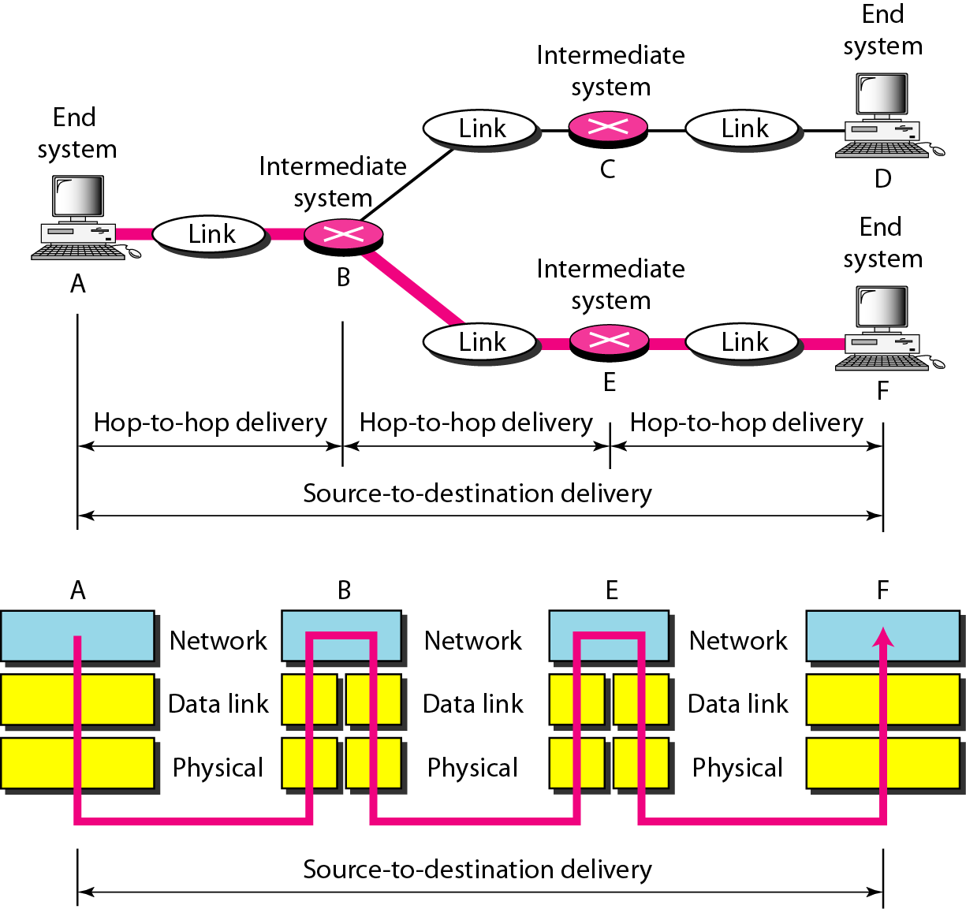
Source to Destination Delivery

Slide 15
Responsibilities of Network Layer
Logical addressing: Physical addressing (May change) handle addressing problem locally.
If packet pass the network boundary, we need another addressing called logical addressing (Never change) .
Routing: Route the packet to final destination.

Slide 16
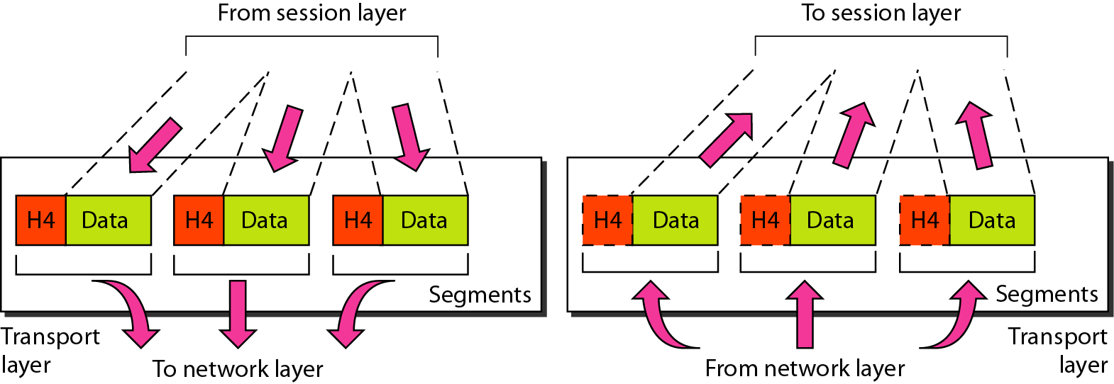
Transport Layer
The transport layer is responsible for process-to-process or end-end delivery of the entire message.
The transport layer ensures that the whole message arrives intact and in order, overseeing both error control and flow control at the process-to-process level.

Slide 17
Responsibilities of Transport Layer
Service point addressing: Computer often run several processes (running programs) at the same time. Process-to-process delivery means delivery from a specific process on one computer to a specific process on the other.
The transport layer header include a type of address called port address.
The network layer gets each packet to the correct computer; the transport layer gets the entire message to the correct process on that computer.
Segmentation and reassembly: a message is divided into transmittable segments, each having a sequence number. These numbers enable the transport layer to reassemble the message correctly upon arrival at the destination.
Connection control: The transport layer can be either connectionless or connection-oriented.
Flow control
Error control

Slide 18
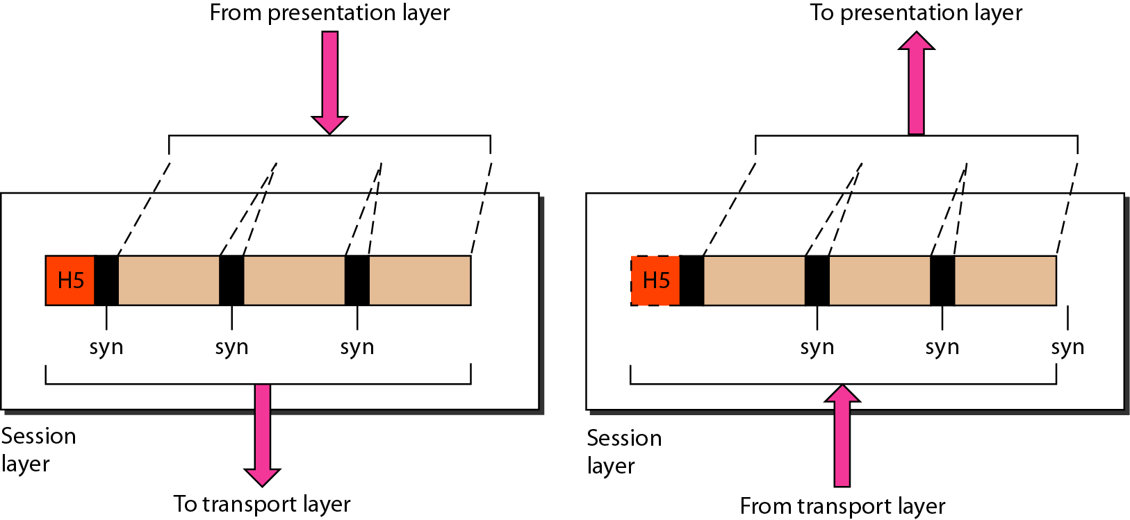
Session layer
The session layer is responsible for dialog control and synchronization.

Slide 19
Responsibilities of Session Layer
Dialog Control: Who’s turn is next? → Half duplex, Full Duplex
Synchronization: Adding checkpoints to stream data.
Ex: System sending 2000 pages. Add check point after each 100th page. So, in case of failure no need to sent whole page.

Slide 20
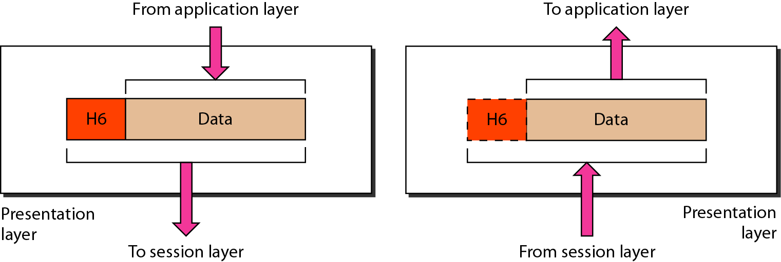
Presentation Layer
The presentation layer is responsible for translation, compression, and encryption.

Slide 21
Responsibilities of Presentation Layer
Translation: Interoperability b/w different encoding formats.
Encryption: Converting plain to cipher text and vice versa.
Compression: Reducing number of bits in multimedia data when transmitting.

Slide 22
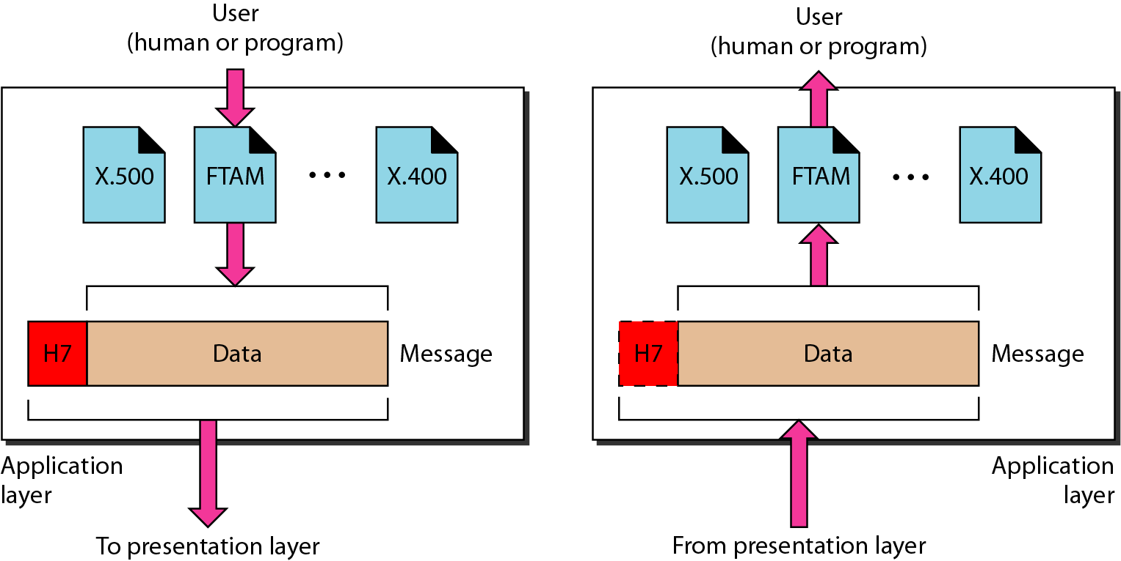
Application Layer
The application layer is responsible for providing services to the user.

Slide 23
Responsibilities of Application Layer
It provides user access to network.
X.500-Directory service.
X.400-Message handling service.
FTAM- File Transfer management.

Slide 24
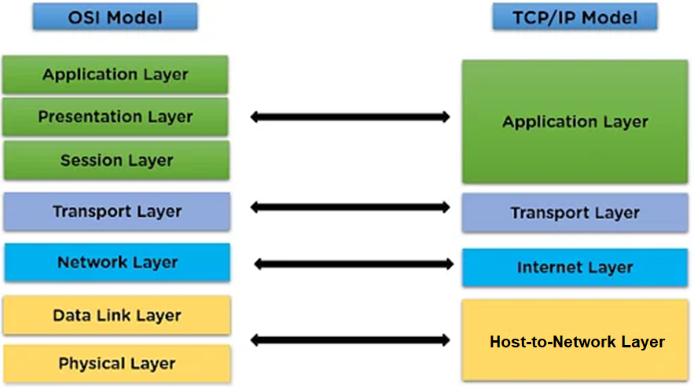
TCP/IP Reference Model

Slide 25
TCP/IP PROTOCOL SUITE
The layers in the TCP/IP protocol suite do not exactly match those in the OSI model.
The original TCP/IP protocol suite was defined as having four layers: host-to-network, internet, transport, and application.

Slide 26
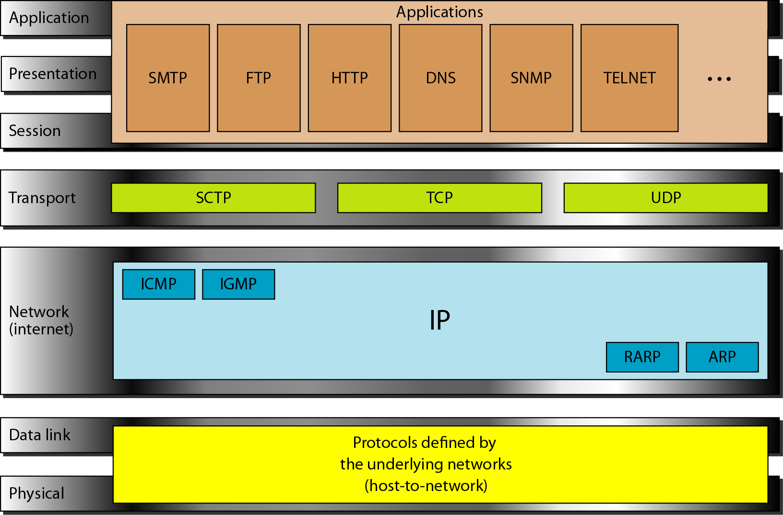
TCP/IP Protocol Suite

Slide 27
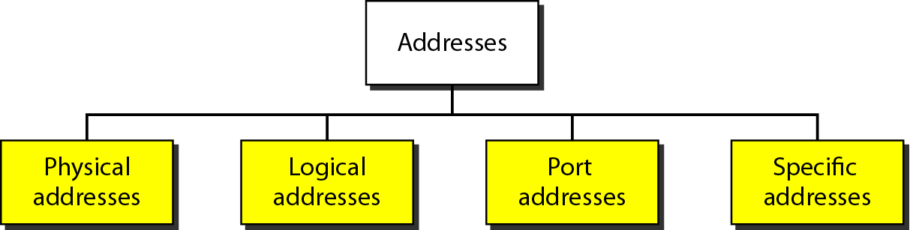
CONTD
Four levels of addresses are used in an internet employing the TCP/IP protocols: physical, logical, port, and specific.

Slide 28
Test Your Understanding
How many layers are there present in TCP/IP protocol?
4 b.5 c.6 d.7
2. How many layers are there present in OSI Reference protocol?
4 b.5 c.6 d.7
3. The application layer provides network services to __________.
A. End-user
B. Ethernet
C. Packet transport
D. All of the above

Slide 29
Test Your Understanding
How many layers are there present in TCP/IP protocol?
4 b.5 c.6 d.7
2. How many layers are there present in OSI Reference protocol?
4 b.5 c.6 d.7
3. The application layer provides network services to __________.
A. End-user
B. Ethernet
C. Packet transport
D. All of the above

Slide 30
CONTD
4.The network layer is used to __________.
A. Transfer packet from source to destination
B. Delimit and synchronize data
C. Transfer data frames
D. All of the above
5. Which of the following layers is used to track the location of the device on the network?
A. Session layer
B. Transport layer
C. Network Layer
D. Datalink layer

Slide 31
CONTD
4.The network layer is used to __________.
A. Transfer packet from source to destination
B. Delimit and synchronize data
C. Transfer data frames
D. All of the above
5. Which of the following layers is used to track the location of the device on the network?
A. Session layer
B. Transport layer
C. Application Layer
D. Datalink layer

Slide 32

SUMMARY
Layered Architecture
OSI Reference Model
TCP/IP Reference Model

Slide 33
TERMINAL QUESTIONS
1. Describe the need for Layered Architecture.
2. Describe in detail the functionalities of each layer in OSI Reference model.
3. Illustrate TCP/IP Reference Model.
4. Differentiate OSI and TCP/IP models.

Slide 34
REFERENCES FOR FURTHER LEARNING OF THE SESSION
Reference Books:
A.S. Tanenbaum, David J. Wetheral “Computer Networks” Pearson, 5th Edition.
Kurose, J and Ross, K Computer Networking: A Top-Down Approach Addison-Wesley- 6th edition.
Sites and Web links:
https://www.geeksforgeeks.org/layers-of-osi-model/

Slide 35
THANK YOU
Team – Network Protocols & Security

